Slide 1


Slide 2

DEMONSTRATING THE WORKING OF LEDs AND PHOTODIODEs BY CONSTRUCTING SIMPLE PROXIMITY SENSOR

Slide 3
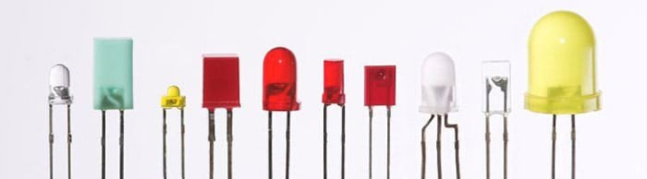
What Is a LED ?
In a Light emitting diode, when electrons and holes recombine, the energy is released in the form of light. Thus, it is termed as Light-emitting diode. The LED operates on the principle of electro-luminance while photodiode works on the principle of the photoconduction.
TYPES OF LEDs

Slide 4
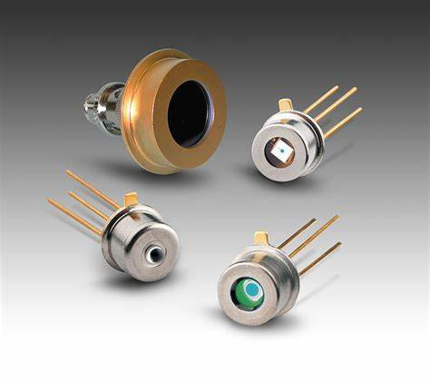
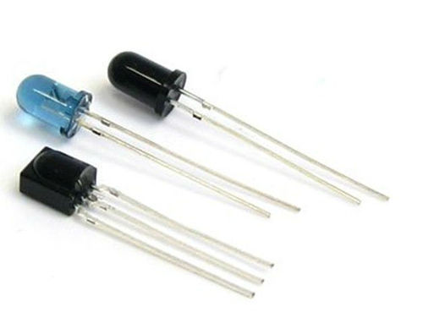
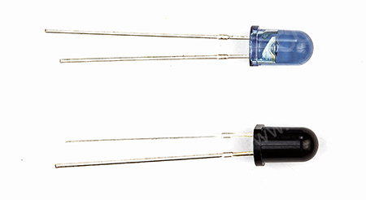
What is a PHOTODIODE ?
A photodiode is a PN-junction diode that consumes light energy to produce an electric current. They are also called a photo-detector, a light detector, and a photo-sensor. Photodiodes are designed to work in reverse bias condition. Typical photodiode materials are Silicon, Germanium and Indium gallium arsenide.
Types of Photodiodes

Slide 5
What is a Proximity Sensor ?
A sensor that can be used for detecting the presence of objects surrounding it without having any physical contact is termed as a proximity sensor. This can be done using the electromagnetic field or electromagnetic radiation beam in which the field or return signal changes in the event of the presence of any object in its surrounding.
Proximity Sensor

Slide 6
How Did we made A Proximity Sensor ?
This is a very simple to make project which consists of very few components . We make this project by soldering the resistor with an IR led and a Photodiode with a 5.6M ohm resistor . They both were connected parallel to each other and a output from photodiode was taken for a BC547 transistor to trigger the indicator LED after incidence of reflected light from the nearby object . And thus this Sensor is constructed with simple electronic components .

Slide 7
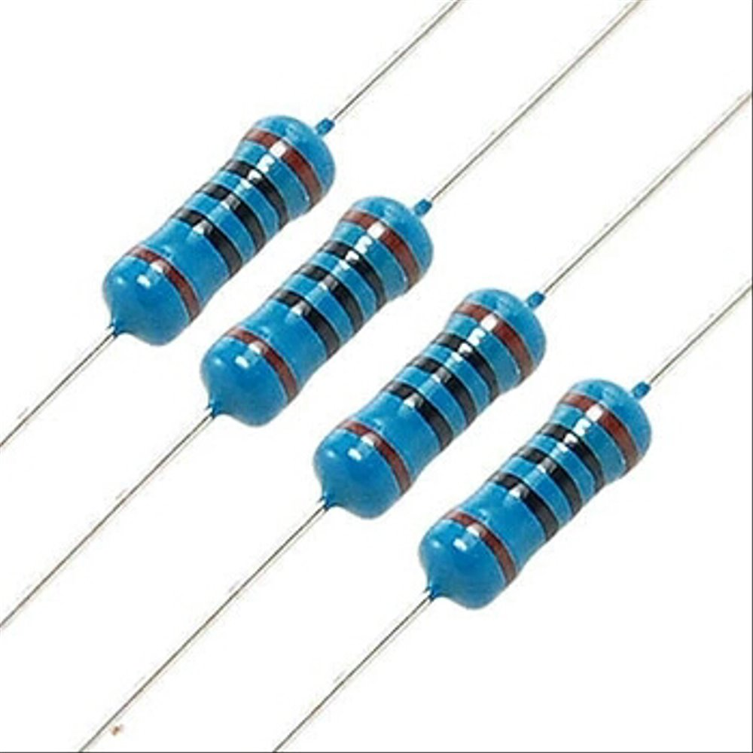
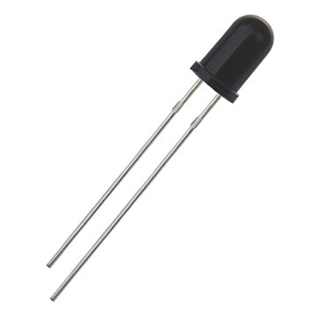
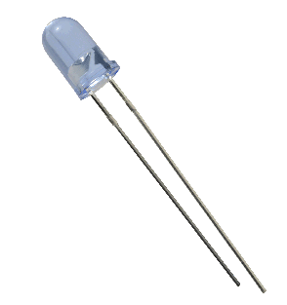
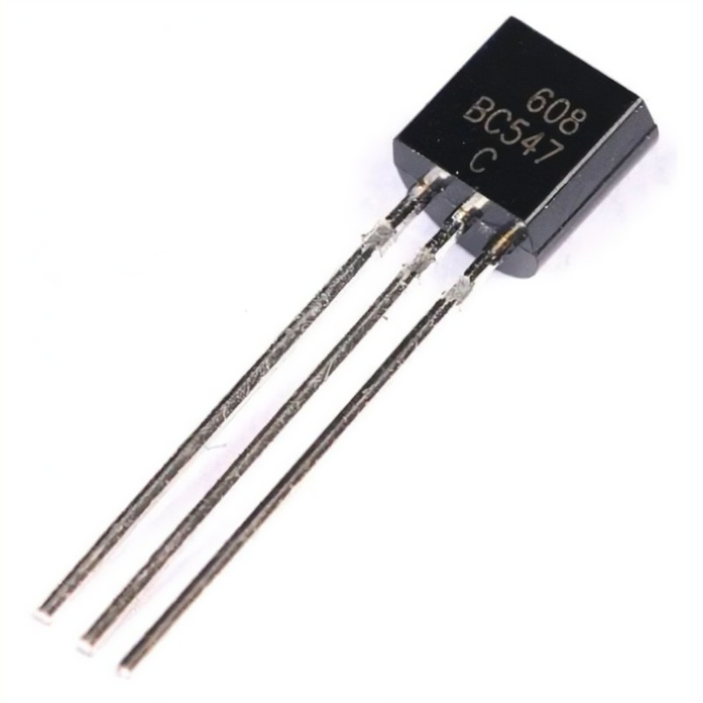
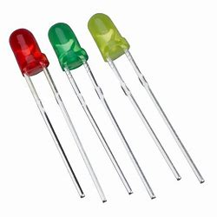
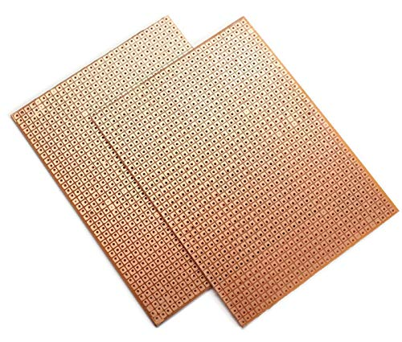
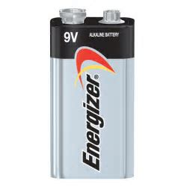

Components Used For Project:
Resistors
Photodiode
IR LED
BC547 Transistor
Indicator LED
Zero PCB
9v Battery
Various Tools.

Slide 8
CIRCUIT DIAGRAM :
IR Light Reflected from nearby Object
IR LED
IR Photodiode
9v
Battery
BC547
Transistor
100ohm
resistor
5.6M ohm
resistor
Switch
Indicator LED

Slide 9
How it works ?
Here when the circuit is close the IR LED connected to the circuit emits Infrared radiations which cannot be seen by naked eyes. IR sensitive Photo diode detects the Infrared Wavelength and starts conducting this triggers the BC547 transistor which is then connected to the Indicator LED terminal thus the indicator LED glows. The Indicator only Glows when the IR sensitive Photo diode starts conducting and Behaves as close switch . the IR sensitive Photodiode detects the light reflected from the nearby objects and thus starts conducting thus it can sense the proximity of the object from photo diodes.

Slide 10
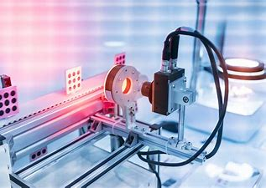
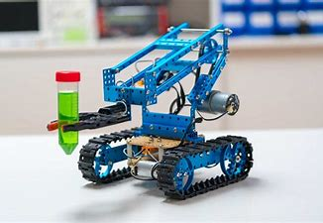
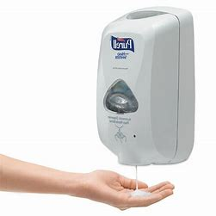
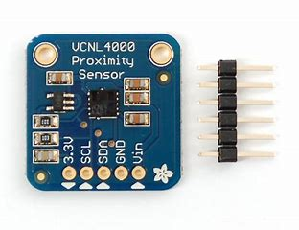
Where it is Used ?
USES of This Device :
1)Automatic Door openers.
2)Automatic Hand sanitizing.
3)Light sensitive Ambience.
4)Robotics .

Slide 11
Skills Aquired:
1) Learnt the application of Photo diode in a circuit.
2) Learnt the uses of various components of electrical circuits.
3) Studied the logic of the transistors .
4) Learnt the construction of the circuit.
5) Understood the working of various electronic components.
6) Learnt to soldier the components on PCB.

Slide 12

Conclusion -
The demonstration of the Photodiode and LED is Carried out successfully , photodiode started conducting at its specific absorbing rate . Thus the properties of photodiode and LEDs can be observed.

Slide 13
CREATORS
Mayur .B. Borgude
F.Y. B.Tech
Computer Science And Design
Rushikesh .M. Shinde
F.Y. B.Tech
Computer Science And Design
GUIDENCE
Prof. Sujata Avhad
Subject Tutor
Basic Electornics And Electrical Engineering

Slide 14


